Slide 1
Raj Koushik Velamarthi
CS 612
Assignment 5
RESTFUL Web Service Implementation + Docker
Valorant Store Customer Data

Slide 2
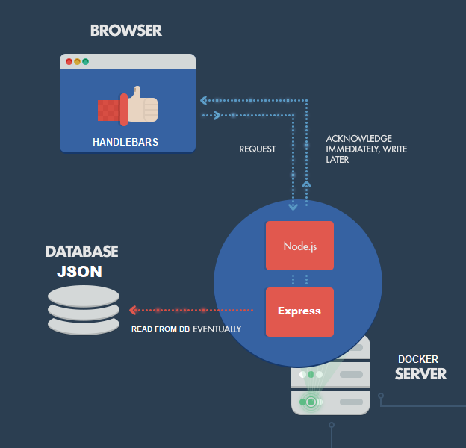
Data Model
01. Create NodeJS App
02. Create JSON DB
Install NodeJS, Express, handlebars packages using NPM package manager
Create a JSON file with customer data which has 4 levels like Customer > Customer Info > Orders > Order details
03. Create API Routes for the data
04. Show data in Templates
05. Dockerize Project
You must create 4 routes where each route displays different kinds of data from the JSON file.
By using handlebars, show the customer data in HTML templates which shows data in meaningful format
Using Docker, Dockerize this app by creating dockerfile and supported files and deploy.

Slide 3

How it works
The Docker server has Nodejs, Express and handlebar packages installed. They get the data from the JSON file based on the API route and filter data and show them in the browser using handlebars templates which are HTML templates to show the data in meaningful manner. Based on the JSON file, It has 4 GET routes in Valorant Store Customer Data. 1) It Shows Customers data in /customers
2) It shows Customer info in /customers/:id
3) It shows Customer orders in /customers/:id/orders
4) It shows Customer order details in /customers/:id/orders/:id

